Slide 1
What Do We Mean by “Accessibility Research”?
A Literature Survey of Accessibility Papers in
CHI and ASSETS from 1994-2019

Slide 2
Shared definitions
Accessibility
Ableism
Proxy
Notes:
Talking points:
Accessibility is a field growing in popularity
- We went into this project with the aim of understanding current trends and norms in accessibility reserach

Slide 3
Shared acronyms
BLV- blind or low vision
DHH- d/Deaf or hard of hearing
IDD- intellectual or developmental disability
CHI- Conference on Human Factors in Computing Systems
ASSETS- Conference on Accessible Computing
Notes:
Talking points:
Accessibility is a field growing in popularity
- We went into this project with the aim of understanding current trends and norms in accessibility reserach

Slide 4
A brief story…
Notes:
Talking points:
Accessibility is a field growing in popularity
- We went into this project with the aim of understanding current trends and norms in accessibility reserach

Slide 5
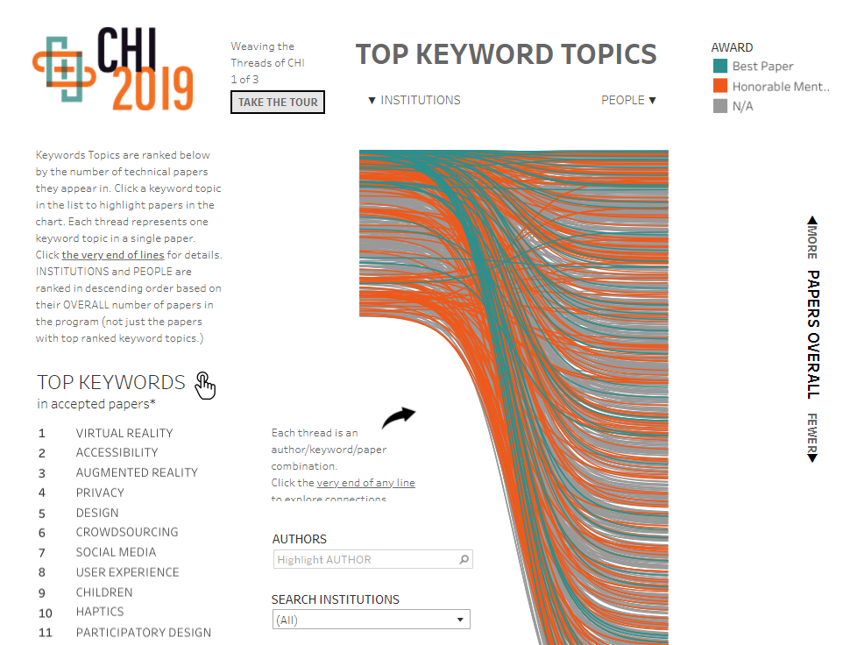
What is “accessibility research”?
Accessibility was the second most used keyword in CHI 2019
Notes:
Talking points:
Accessibility is a field growing in popularity
- We went into this project with the aim of understanding current trends and norms in accessibility reserach

Slide 6
ASSETS
SIGACCESS Conference on Accessible Computing
Notes:
Talking points:
Accessibility is a field growing in popularity
- We went into this project with the aim of understanding current trends and norms in accessibility reserach

Slide 7
What Do We Mean by “Accessibility Research”?
A Literature Survey of Accessibility Papers in
CHI and ASSETS from 1994-2019

Slide 8
Overview
Dataset
Curation
Data Analysis
Results & Insights

Slide 9
Dataset Curation

Slide 10
Defining our scope
What is an accessibility-focused paper?
Notes:
Not an easy question, overlaps with many fields including rehabilitation medicine, gerontological studies, education, health, HCI

Slide 11
Defining our scope: considerations
Encompass papers that deal with accessibility and disability
Do not bias the sample towards popular topics
Notes:
Quote vines?

Slide 12
Defining our scope: criteria
All ASSETS papers
All CHI papers that use one of:
“disability”, “accessibility”, “impair”, “assistive technology”
In the:
Abstract, title, author keywords

Slide 13
Defining our datasets
Qualitative Dataset
All ASSETS papers and the relevant CHI papers from 2010-2019
Quantitative Dataset
All ASSETS papers and the relevant CHI papers from 1994-2019

Slide 14
Collecting the data
Searched all full papers in the CHI and ASSETS proceedings for key words
Returned 594 papers returned
Manually reviewed all candidates
215 relevant
Key words
“disab-”
“impair-”
“access-”
“assistive tech-”

Slide 15
Defining our datasets
Qualitative Dataset
CHI | ASSETS | Total
215 | 291 | 506
Notes:
291 ASSETS + 215 CHI = 506 Papers

Slide 16
Defining our datasets
Qualitative Dataset
Quantitative Dataset
CHI | ASSETS | Total
215 | 291 | 506
260 | 576 | 836
Notes:
291 ASSETS + 215 CHI = 506 Papers
576 ASSETS + 260 CHI = 836 Papers

Slide 17
Checking for false negatives
Sampled random 100 CHI papers from 2010-2019 and 100 from 1994-2009
Three papers were potential false negatives (rate of 1.5%)
Notes:
6628 CHI papers total, took a sample of

Slide 18
Data Analysis

Slide 19
Analysis
Qualitative Dataset
Qualitative codes for 506 papers
Quantitative Dataset
Paper and keyword counts for 836 papers

Slide 20
Analysis
Qualitative Dataset
Qualitative codes for 506 papers
Quantitative Dataset
Paper and keyword counts for 836 papers

Slide 21
Qualitative coding: process
Develop Codes
Combination inductively and deductively
IRR
Coded 25 paper chunks until reached .76
Apply Codes
To the 506 papers
QA
Reviewed, discussed and verified codes
Notes:
Quote vines?

Slide 22
Qualitative coding: themes
Community of focus | Blind or low vision, autism …
Methods | Interview, survey …
User groups | People with disabilities, older adults…
Use of proxies | Yes, no
Ability-based comparison | Yes, no
Participant count | Number of participants per paper
Contribution type | Empirical, artifact…
Issue addressed | Increase independence, support communication
User study location | Laboratory, remote…
Use of participatory design | Yes, no
Notes:
Quote vines?

Slide 23
Qualitative coding: themes
Community of focus | Blind or low vision, autism …
Methods | Interview, survey …
User groups | People with disabilities, older adults…
Use of proxies | Yes, no
Ability-based comparison | Yes, no
Participant count | Number of participants per paper
Contribution type | Empirical, artifact…
Issue addressed | Increase independence, support communication
User study location | Laboratory, remote…
Use of participatory design | Yes, no
Notes:
Quote vines?

Slide 24
Analysis
Qualitative Dataset
Qualitative codes for 506 papers
Quantitative Dataset
Paper and keyword counts for 836 papers

Slide 25
Quantitative analysis
Comparing the amount of research papers and CHI and ASSETS over time
Analyzing keyword frequency over time

Slide 26
Results & Insights

Slide 27
Who do we study?

Slide 28
Communities of focus
Overwhelmingly focused on people who are blind or low vision
Notes:
BLV 43.5%
MI 14.2%
DHH11.3%
Autism 6.1%
IDD 2.8%

Slide 29
Who do we study?
Considerable focus on people who are blind or low vision
Less focus on people with intellectual or developmental disabilities, autism, or cognitive impairments

Slide 30
Who do we study?
Few papers looking at multiple communities of focus – 7.1%
Few papers with people with multiple types of disabilities – <1.0%
Few papers focused on mental health or chronic illness

Slide 31
What methods do we use?

Slide 32
Methods
Almost all have user studies (94.3%)
Use of qualitative and quantitative methods
Most used multiple methods (56.4%)
Notes:
Interviews 42.1%
Usability testing 41.7%
Contr exp 34.6%
Focus group 5.9%
Case study 4.0%

Slide 33
Locations
Laboratories were popular locations (32.1%), but more papers are using convenient locations for the participant (34.1%)
Many studies had at least one study with an unclear location (39.6%)

Slide 34
Participants engaged
Almost all papers included disabled or older adult participants (90.1%)
The other 9.9% often engaged care givers or specialists
Notes:
Pwd 84.7%
P w/o DA 23.1%
Specialist 17.0%
Caregiviers 9.4%

Slide 35
Participants engaged
Group | M
DHH | 28
General DA | 19
Nondisabled | 16
Cognitive | 16
Older Adult | 15
BLV | 13
IDD | 11.5
Motor/ Physical | 10
Autism | 9
Caregivers | 7.5
Specialists | 7
Median number of participants with disabilities or older adults recruited per paper was 13
However, specific subpopulations diverged from this median

Slide 36
What methods do we use?
Median sample sizes for some populations are small
Surprisingly, low utilization of methods suited for small samples (e.g., case studies, single-subject experiments)
Consider whether broader human-computer interaction norms are appropriate for an accessibility paper
Notes:
Median sample sizes are small for some groups (e.g., autism is 9). We are not saying this is a bad thing.
Repeated, in depth engagement places a burden on participants, for groups with few people or very personalized needs that don’t generalize
However, given the small samples, we were surprised we didn’t see methods best suited for small samples
Perhaps this is because reviewers can be critical of papers with sample sizes < 30.

Slide 37
How are participants engaged?

Slide 38
How are nondisabled participants engaged?
Stakeholders
Comparing them with disabled or older adult participants
Proxies for information

Slide 39
How are nondisabled participants engaged?
Stakeholders
Comparing them with disabled or older adult participants
Proxies for information

Slide 40
Ability-based comparisons
Comparing the performance or data of disabled or older adult participants with those who do not belong to these groups
Used in 13.6% of papers

Slide 41
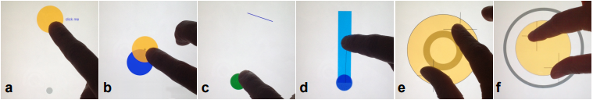
Ability-based comparisons
Establish a “baseline” or “control group”
Example: Investigating whether touch screen interaction “reduce[d] the performance gap between older and younger adults” compared to using a mouse
(Findlater, CHI ’13)
Notes:
40
Leah Findlater, Jon E. Froehlich, Kays Fattal, Jacob O. Wobbrock, and Tanya Dastyar. 2013. Age-related differences in performance with touchscreens compared to traditional mouse input. In Proceedings of the SIGCHI Conference on Human Factors in Computing Systems (CHI ’13), 343–346. https://doi.org/10.1145/2470654.2470703

Slide 42
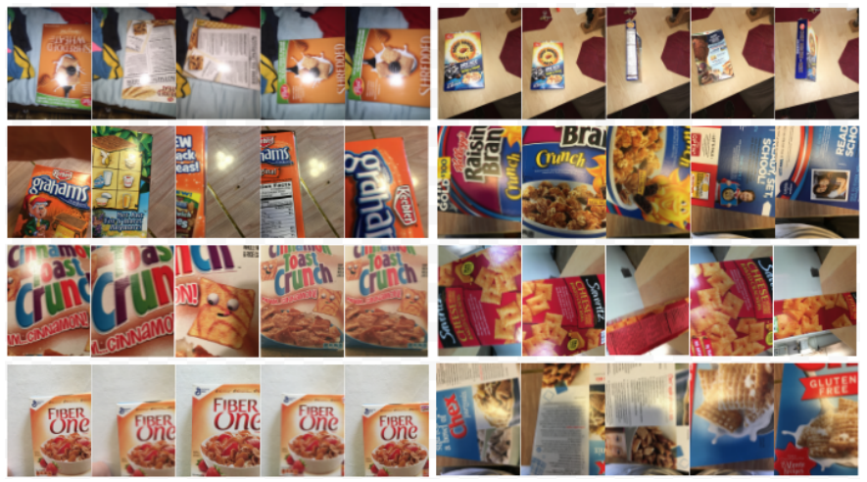
Ability-based comparisons
Studying collaboration opportunities across abilities
Example:“Explor[ing] the benefits of having a sighted person training a blind user’s personal object recognizer.”
(Kacorri, CHI ’17)
Notes:
70
Hernisa Kacorri, Kris M. Kitani, Jeffrey P. Bigham, and Chieko Asakawa. 2017. People with Visual Impairment Training Personal Object Recognizers: Feasibility and Challenges. In Proceedings of the 2017 CHI Conference on Human Factors in Computing Systems (CHI ’17), 5839–5849. https://doi.org/10.1145/3025453.3025899

Slide 43
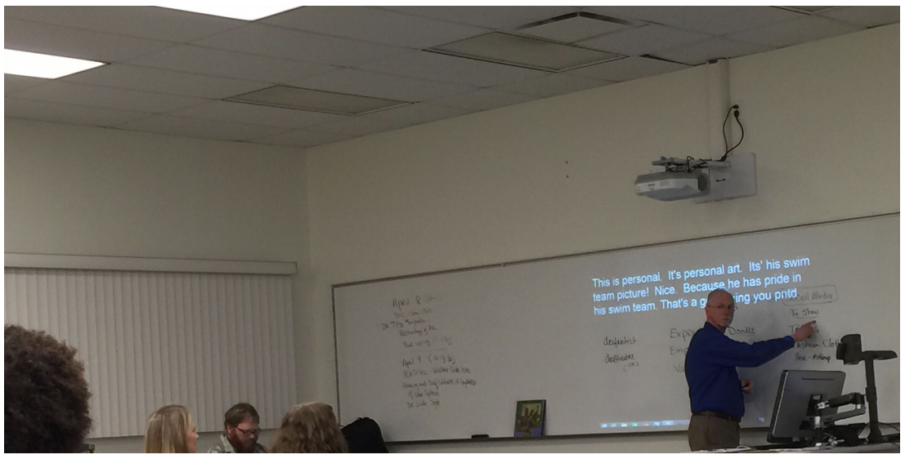
Ability-based comparisons
Understand experiences and needs across abilities
Example: Examining how captions affect both DHH and hearing students in class.
(Kushalnagar, ASSETS ’15)
Notes:
82
Raja S. Kushalnagar, Gary W. Behm, Aaron W. Kelstone, and Shareef Ali. 2015. Tracked Speech-To-Text Display: Enhancing Accessibility and Readability of Real-Time Speech-To-Text. In Proceedings of the 17th International ACM SIGACCESS Conference on Computers & Accessibility (ASSETS ’15), 223–230. https://doi.org/10.1145/2700648.2809843

Slide 44
How are nondisabled participants engaged?
Stakeholders
Comparing them with disabled or older adult participants
Proxies for information

Slide 45
How are nondisabled participants engaged?
Stakeholders
Comparing them with disabled or older adult participants
Proxies for information

Slide 46
Proxies
Asking a nondisabled person about a disabled person or older adult’s perspective about a situation or technology
Used in 8% of papers
Did not often explain why they used proxies

Slide 47


Proxies
“Since some of our participants had verbal difficulties, we asked staff members to identify the preferred interests for each participant prior to the date of the study”
(Morris, ASSETS ’10)
Notes:
109
Robert R. Morris, Connor R. Kirschbaum, and Rosalind W. Picard. 2010. Broadening accessibility through special interests: a new approach for software customization. In Proceedings of the 12th international ACM SIGACCESS conference on Computers and accessibility (ASSETS ’10), 171–178. https://doi.org/10.1145/1878803.1878834

Slide 48
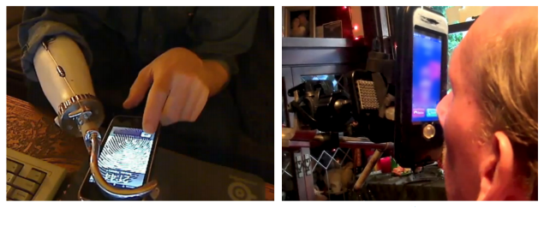
Proxies
“In many cases, a third person completed the survey on the user’s behalf, either because the primary user was a child or because it was difficult for the primary user to do”
(Anthony, CHI ’13)
Notes:
8
Lisa Anthony, YooJin Kim, and Leah Findlater. 2013. Analyzing user-generated youtube videos to understand touchscreen use by people with motor impairments. In Proceedings of the SIGCHI Conference on Human Factors in Computing Systems (CHI ’13), 1223–1232. https://doi.org/10.1145/2470654.2466158

Slide 49
Proxies
Were most often used when studying Autistic people
Were least often used when studying DHH people
Notes:
Autism 22.6%
IDD 21.4%
Cog 17.4%
BLV 4.50%

Slide 50
Who is engaged in studies and how?
Almost all papers involved people with disabilities or older adults (90.1%)
However, we found trends that, without care, can reinforce ableist beliefs
Proxies
Ability-based comparisons
Notes:
We saw some good things!
But…
We saw examples today that suggest that proxies may be used when communication or ability to comply with study procedures is “challenging”, particularly in research about ….
Triangulation
Not all ability based are bad!

Slide 51
Growth over time

Slide 52
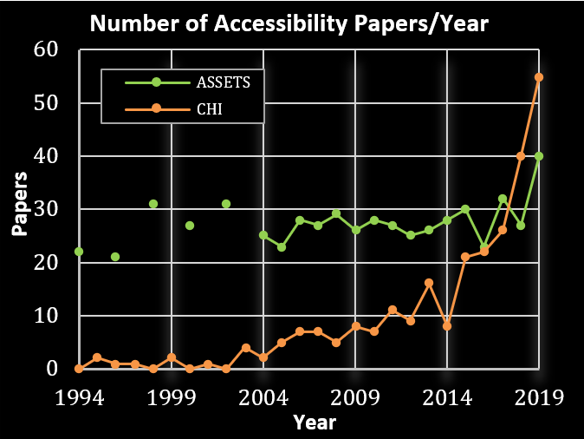
Accessibility research is growing

Slide 53
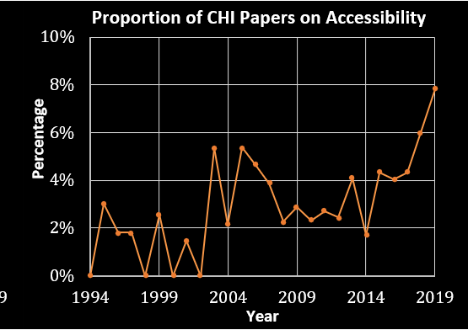
Accessibility research is growing

Slide 54
Parting thoughts
Accessibility research is growing
The community needs to take time to reflect on norms and trends
Notes:
In sum, accessibility research is growing! Now more than ever is an important time to reflect on the norms and trends in our research community to ensure that they are effective both in creating high quality research and reaffirming the rights and comfort of the people our research aims to serve.
We hope that this work spurs these reflections and discussions within the community and serves as a guide to help onboard newcomers t the community

Slide 55
Limitations
Focus only on CHI and ASSETS
Concretizing boundaries between disabilities
Our codes were influenced by our positionality

Slide 56
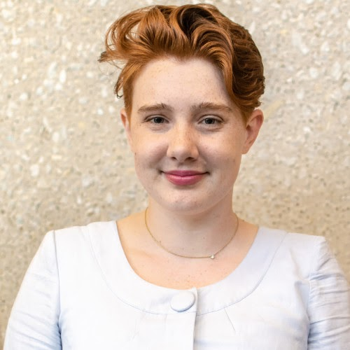
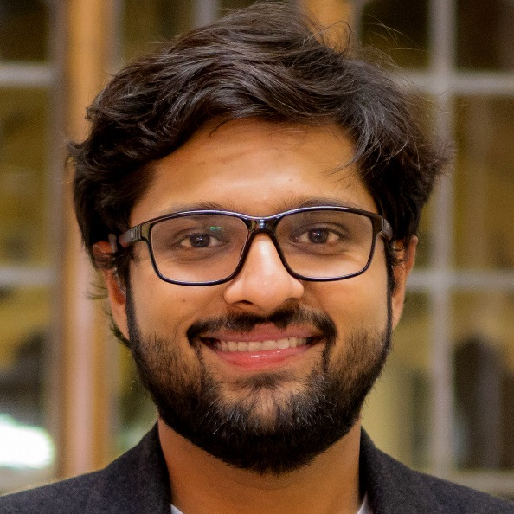
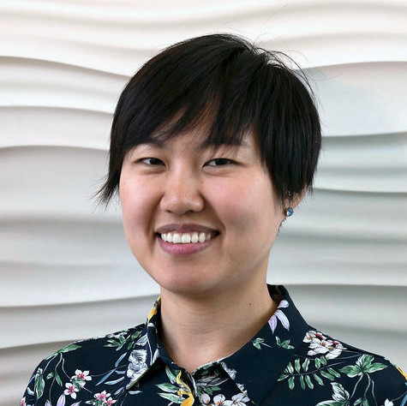
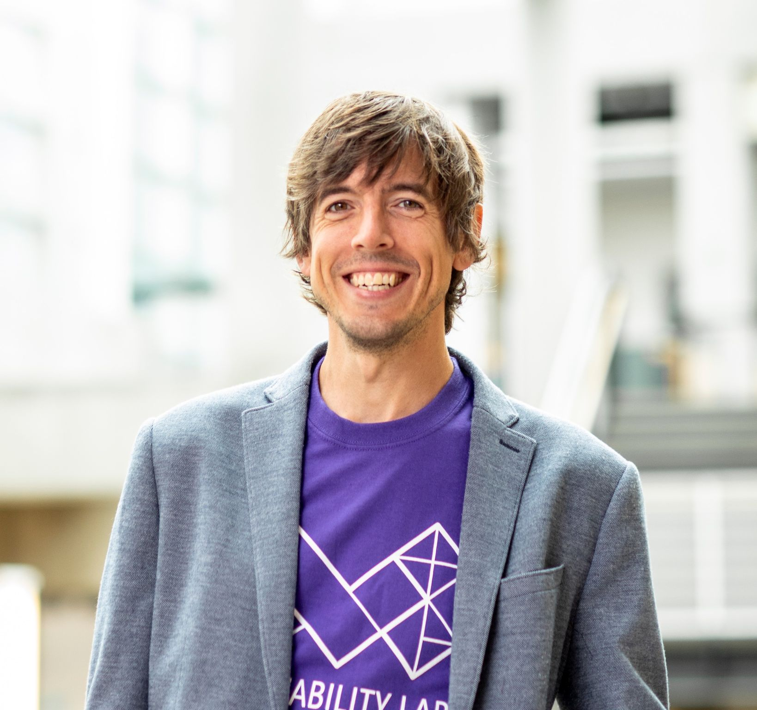
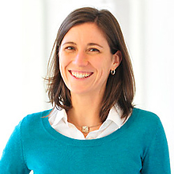
Acknowledgements
Thank you to my wonderful coauthors
Emma McDonnell
ejm249@uw.edu
Dhruv Jain
djain@uw.edu
Lucy Lu Wang
lucyw@allenai.org
Jon E. Froehlich
jonf@uw.edu
Leah Findlater
leahkf@uw.edu
And my colleagues who helped me prepare for this presentation:
Aashaka Desai, Taylor Gotfrid, Jesse Martinez, Emma McDonnell, and Daniel Revier

Slide 57
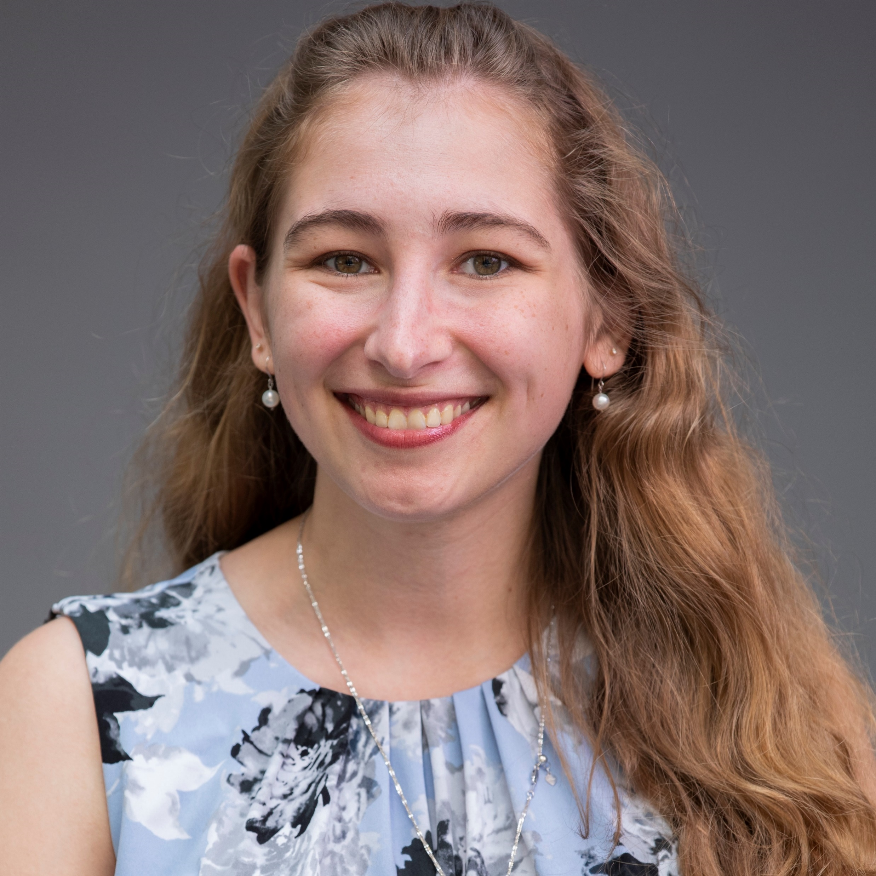
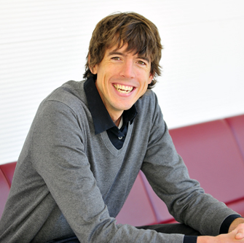
Acknowledgements (CHI)

